Slide 1

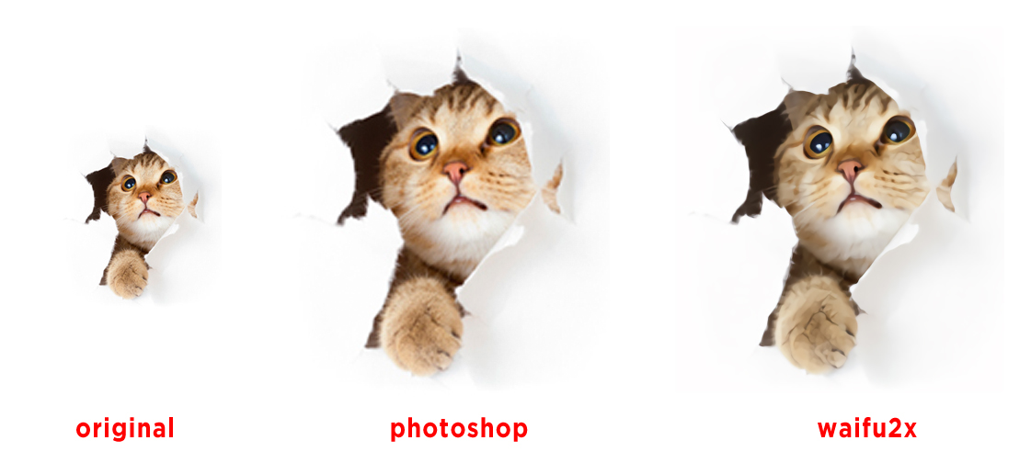
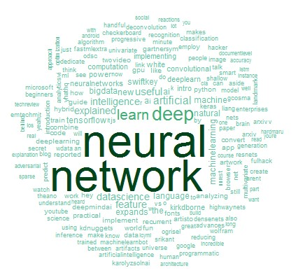
CNIT 355 Final Presentation
Waifu Photozoom Pro

Slide 2
Team Members
Xirui Zhong
Shuai Shao
Andrea Nguyen

Slide 3
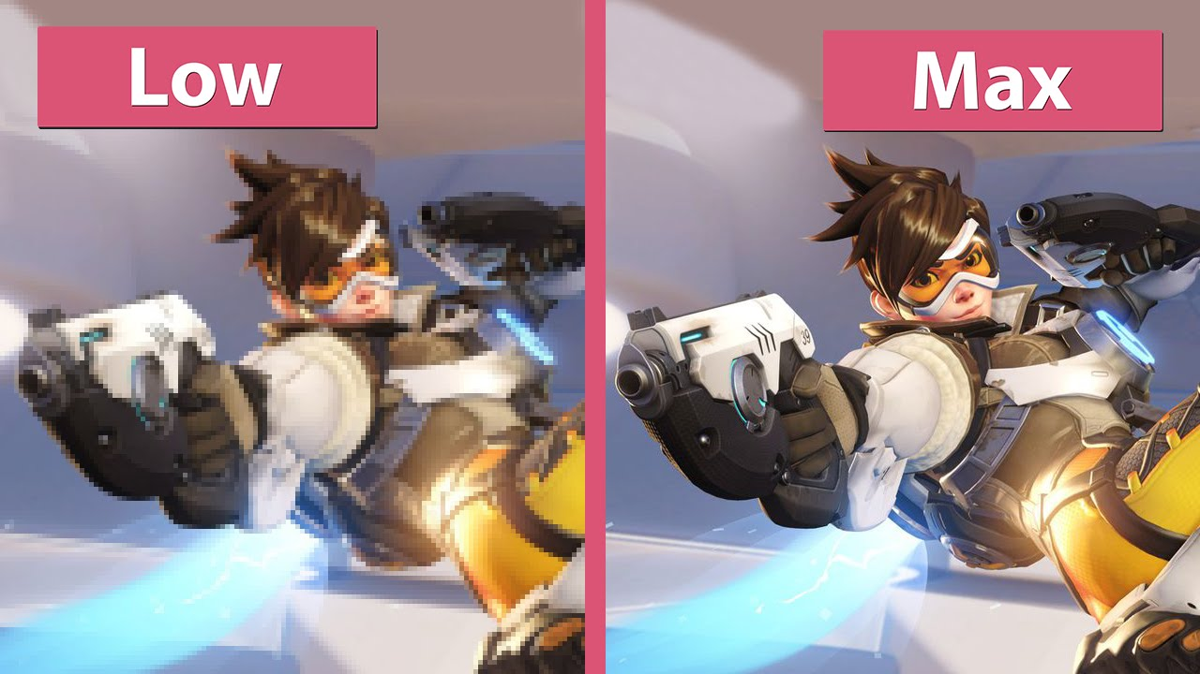
Background
Waifu2x is used for upscaling images and removing JPG noise artifacts using deep convolutional neural networks.
Motivation
Replacing low resolution photos with higher ones.
Objective
Help people finding high resolution photos they want.

Slide 4
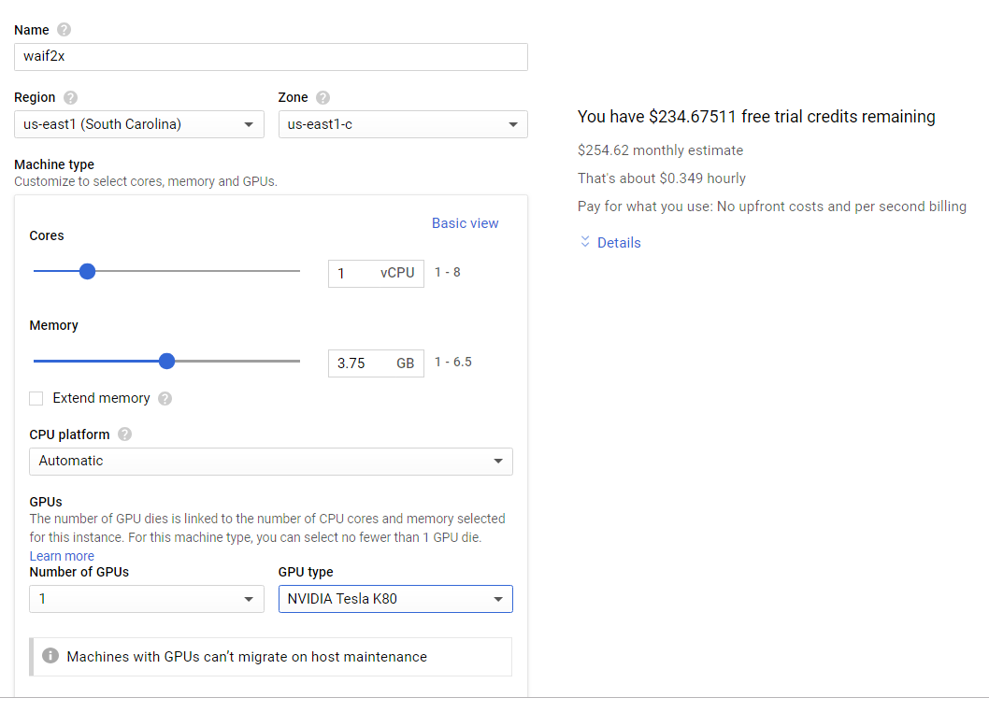
Approachs
Step 1: Build the GPU Server.
Tools: Google Cloud
Techniques: Cloud Server

Slide 5
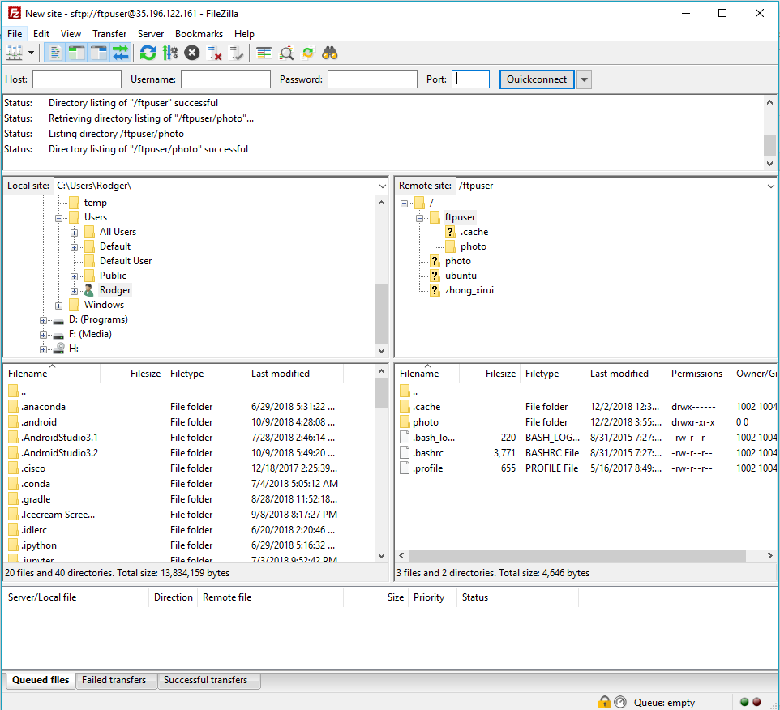
Approachs Cont.
Step 2: Implement SFTP and Waifu2x.
Tools: GitHub, FileZilla
Techniques: SFTP transport protocol and Convolutional Neural Network（CNN）

Slide 6
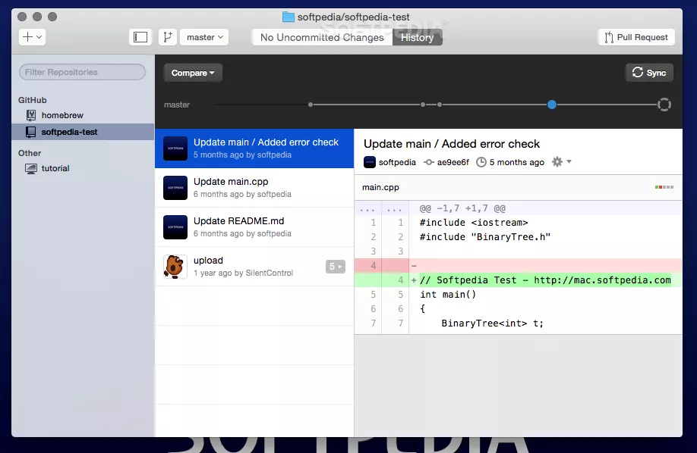

Approachs Cont.
Step 3: Use Android Studio and GitHub to write and share codes.
Tools: Android Studio, BlueStacks Emulater and GitHub Desktop
Techniques: Files IO, thread, LiteSQL DB and some other Andorid mechanisms

Slide 7
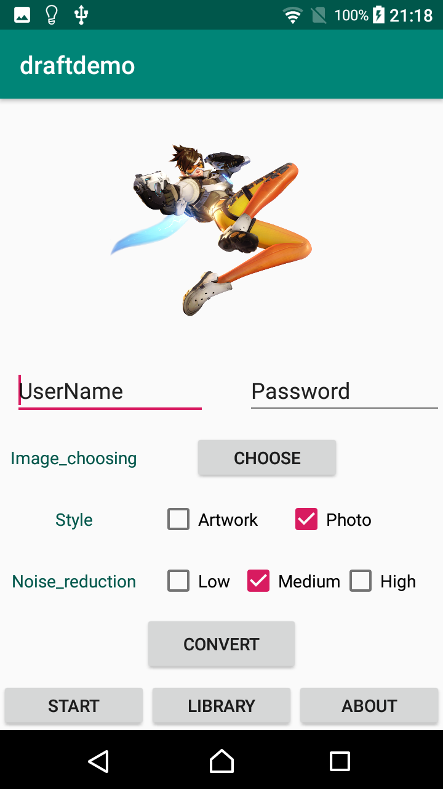
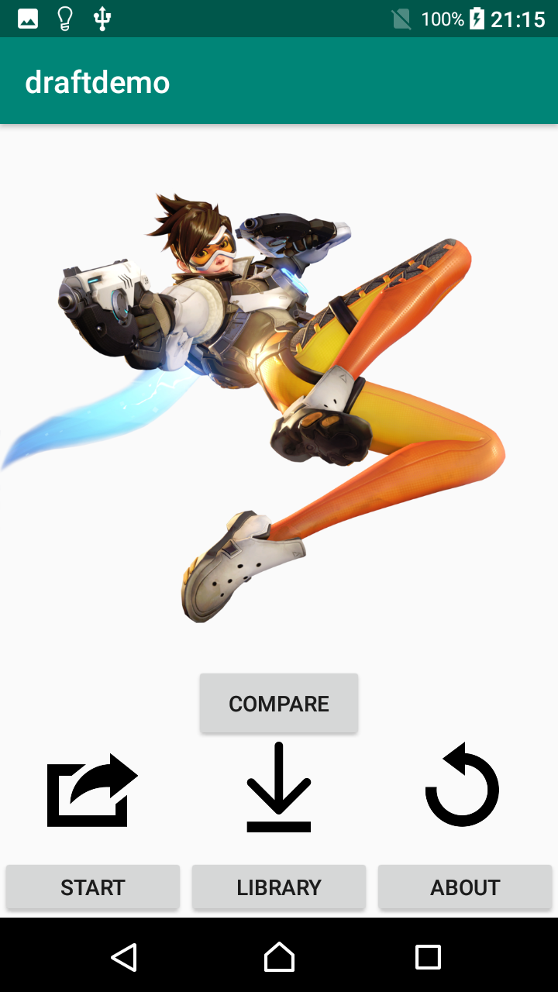
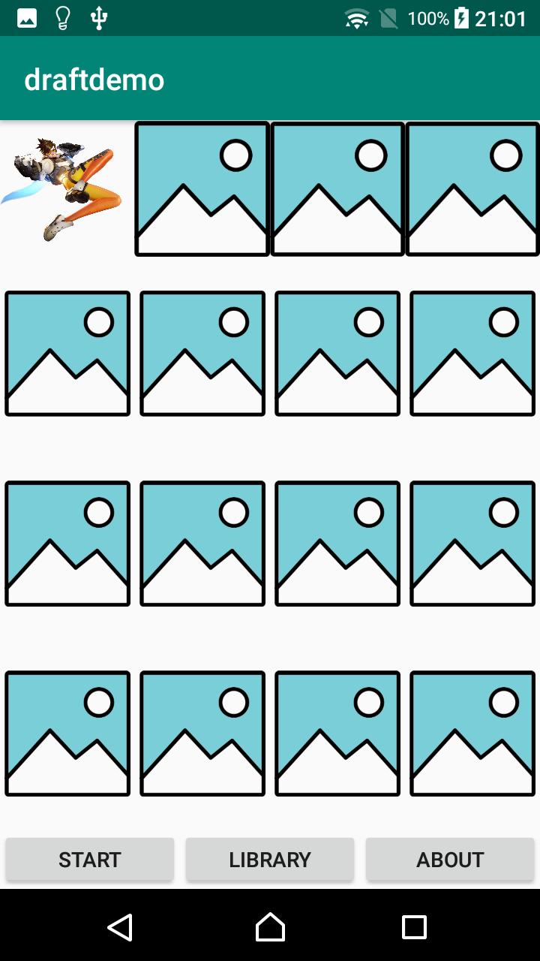
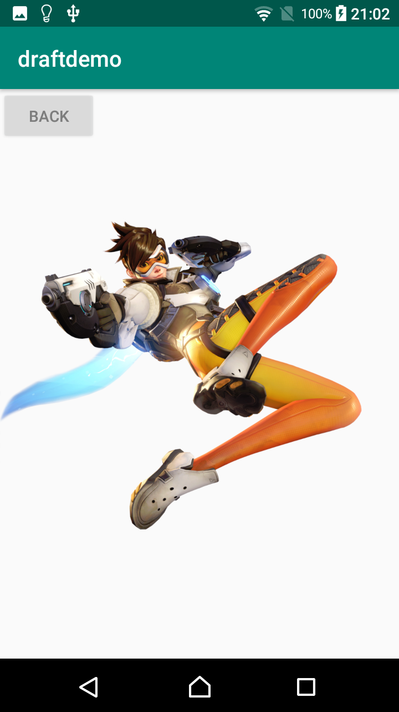
Demo

Slide 8
Conclusion
Waifu2x is a useful program that we have allowed to be accessed on mobile devices
Future Plans
Increase security for server
Add feature to crop images

Slide 9
Individual Contributions
Xirui Zhong: set up sftp and deep learning server, wrote android sftp codes, wrote bash script to automatically execute Waifu2x code
Shuai Shao: designed UI, wrote codes for image choosing, converting and uploading
Andrea Nguyen: designed library, image downloading, displaying, SQL DB

Slide 10

Reference
https://www.youtube.com/watch?v=uojZp-kHE4k
https://thewallpaper.co/overwatch-futuristic-shooterartworks-abstract-vector-action-high-resolution-stock-photos-fighting-hd-wallpapers-mecha-warrior-scifi/
https://i1.wp.com/anith.com/wp-content/uploads/2018/08/GitHub_11.png?fit=918%2C598&ssl=1
http://i.imgur.com/FQcjv5W.jpg
https://github.com/nagadomi/waifu2x
https://www.ayima.com/wp-content/uploads/wcloud.jpg
http://www.semi.org/en/semi-arizona-forum-artificial-intelligence-machine-learning-deep-learning-applications-0

